Slide 1
CSC230
Sorting

Slide 2
Sorting Algorithms
A sorting algorithm is an algorithm that puts elements of a list in a certain order.
0
1
2
3
4
5
6
"Cat"
"Ape"
"Ear"
"Go"
"Pal"
"Mop"
"Elk"
0
1
2
3
4
5
6
"Ape"
"Cat"
"Ear"
"Elk"
"Go"
"Mop"
"Pal"
https://en.wikipedia.org/wiki/Sorting_algorithm

Slide 3
Sorting Algorithms
bubble sort: swap adjacent pairs that are out of order
selection sort: look for the smallest element, move to front
insertion sort: build an increasingly large sorted front portion
merge sort: recursively divide the array in half and sort it
quick sort: recursively partition array based on a middle value
Other specialized sorting algorithms:
heap sort: place the values into a sorted tree structure
shell sort: a generalization of sorting by exchange (bubble sort) or sorting by insertion (insertion sort)
bucket sort: cluster elements into smaller groups, sort them
radix sort: sort integers by last digit, then 2nd to last, then ...
...
https://www.toptal.com/developers/sorting-algorithms/

Slide 4
Sorting Algorithms
There is no single sorting algorithm that is ideal in all situations.
An ideal sorting algorithm depends on the initial state of an array.
Initial conditions include:
Purely random item order
Items nearly sorted
Items in reverse order
Many repeated items (few unique)

Slide 5
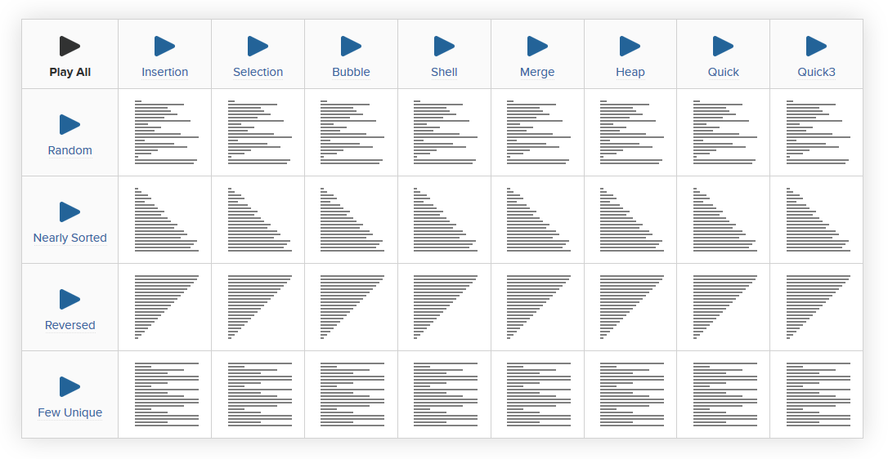
https://www.toptal.com/developers/sorting-algorithms/

Slide 6
Bubble Sort
An easy way to arrange data in ascending or descending order.
Items "bubble" down the array until they find the right location.
Make repeated passes, swapping adjacent values
Slower than selection sort (requires more swaps)
Informal Algorithm
Compare adjacent items in a list. If the first is greater than the second, swap them.
Repeat for all adjacent pairs in a list, in order, from the beginning to the end.
When complete, the last item is the largest.
Repeat process, excluding last list item each, until all items are sorted.

Slide 7
Bubble Sort
Initial array:
After 1st Pass:
index | 0 | 1 | 2 | 3 | 4 | 5 | 6 | 7 | 8 | 9 | 10 | 11 | 12 | 13 | 14 | 15 | 16
value | 22 | 18 | 12 | -4 | 27 | 30 | 36 | 50 | 7 | 68 | 91 | 56 | 2 | 85 | 42 | 98 | 25
index | 0 | 1 | 2 | 3 | 4 | 5 | 6 | 7 | 8 | 9 | 10 | 11 | 12 | 13 | 14 | 15 | 16
value | 18 | 12 | -4 | 22 | 27 | 30 | 36 | 7 | 50 | 68 | 56 | 2 | 85 | 42 | 91 | 25 | 98
22
50
91
98

Slide 8
Bubble Sort (for Strings)
void bubbleSort(string[] arr, int n) { string tmp; for(int i=0; i < n; i++) { for(int j=1; j < (n-i); j++) { if( arr[j-1].compare( arr[j] ) > 0 ) { // swap tmp = arr[j-1]; arr[j-1] = arr[j]; arr[j] = tmp; } } } }

Slide 9
Selection Sort
Orders a list of values by repeatedly putting the smallest or largest unplaced value into its final position.
Bubble Sort is inefficient for large arrays because items only move by one position at a time.
Selection Sort moves items immediately to their final position in the array so it makes fewer swaps.
Informal Algorithm
Look through the list to find the smallest value.
Swap it so that it is at index 0.
Look through the remaining list to find the second-smallest value.
Swap it so that it is at index 1.
Repeat until all values are in their proper places.

Slide 10
Selection Sort Example
Initial array:
After 1st Pass:
After 2nd Pass
After 3rd Pass
index | 0 | 1 | 2 | 3 | 4 | 5 | 6 | 7 | 8 | 9 | 10 | 11 | 12 | 13 | 14 | 15 | 16
value | 22 | 18 | 12 | -4 | 27 | 30 | 36 | 50 | 7 | 68 | 91 | 56 | 2 | 85 | 42 | 98 | 25
index | 0 | 1 | 2 | 3 | 4 | 5 | 6 | 7 | 8 | 9 | 10 | 11 | 12 | 13 | 14 | 15 | 16
value | -4 | 18 | 12 | 22 | 27 | 30 | 36 | 50 | 7 | 68 | 91 | 56 | 2 | 85 | 42 | 98 | 25
index | 0 | 1 | 2 | 3 | 4 | 5 | 6 | 7 | 8 | 9 | 10 | 11 | 12 | 13 | 14 | 15 | 16
value | -4 | 2 | 12 | 22 | 27 | 30 | 36 | 50 | 7 | 68 | 91 | 56 | 18 | 85 | 42 | 98 | 25
index | 0 | 1 | 2 | 3 | 4 | 5 | 6 | 7 | 8 | 9 | 10 | 11 | 12 | 13 | 14 | 15 | 16
value | -4 | 2 | 7 | 22 | 27 | 30 | 36 | 50 | 12 | 68 | 91 | 56 | 18 | 85 | 42 | 98 | 25

Slide 11
Selection Sort (for Strings)
public void selectionSort(string[] arr, int n) { string tmp; // Repeat for all starting items excluding the last for (int i=0; i<n-1; i++) { // Assume the smallest value is the first of this round int smallest = i; // Compare first to all remaining for (int j=i+1; j<n; j++) { // If the jth item is smaller than smallest, set new smallest if ( arr[j].compare( arr[smallest] ) < 0 ) { smallest = j; } } // Swap the value at start position i with the value at smallest tmp = arr[i]; arr[i] = arr[smallest]; arr[smallest] = tmp; } }

Slide 12
Insertion Sort
Shift each element into a sorted sub-array
Faster than selection sort (examines fewer values)
It is very simple.
It is very efficient for small data sets.
Informal Algorithm
Iterate down array
For each item, iterate backwards to find where item belong
Swap items along way back down array until position found
Continue for all items in array

Slide 13
Insertion Sort
Initial array:
After 7th Swap:
index | 0 | 1 | 2 | 3 | 4 | 5 | 6 | 7 | 8 | 9 | 10 | 11 | 12 | 13 | 14 | 15 | 16
value | 22 | 18 | 12 | -4 | 27 | 30 | 36 | 50 | 7 | 68 | 91 | 56 | 2 | 85 | 42 | 98 | 25
index | 0 | 1 | 2 | 3 | 4 | 5 | 6 | 7 | 8 | 9 | 10 | 11 | 12 | 13 | 14 | 15 | 16
value | -4 | 12 | 18 | 22 | 27 | 30 | 36 | 50 | 7 | 68 | 91 | 56 | 2 | 85 | 42 | 98 | 25
sorted sub-array (indexes 0-7)
7

Slide 14
Insertion Sort (for Strings)
public void insertionSort(string[] arr, int n)
{ string tmp; for (int i=1; i < n; i++)
{ for (int j=i; j > 0 ; j--)
{ if ( arr[j].compare( arr[j-1] ) < 0 ) { tmp = arr[j]; arr[j] = arr[j-1]; arr[j-1] = tmp; } } } }

Slide 15
Mergesort
Mergesort (divide-and-conquer)
Divide array into two halves.
A
L
G
O
R
I
T
H
M
S
A
L
G
O
R
I
T
H
M
S
divide

Slide 16
Mergesort
Mergesort (divide-and-conquer)
Divide array into two halves.
Recursively sort each half.
A
L
G
O
R
I
T
H
M
S
A
L
G
O
R
I
T
H
M
S
divide
A
G
L
O
R
H
I
M
S
T
sort

Slide 17
Mergesort
Mergesort (divide-and-conquer)
Divide array into two halves.
Recursively sort each half.
Merge two halves to make sorted whole.
A
L
G
O
R
I
T
H
M
S
A
L
G
O
R
I
T
H
M
S
divide
A
G
L
O
R
H
I
M
S
T
sort
A
G
H
I
L
M
O
R
S
T
merge

Slide 18
Merging
Merge.
Keep track of smallest element in each sorted half.
Insert smallest of two elements into auxiliary array.
Repeat until done.
smallest
smallest
A
G
L
O
R
H
I
M
S
T
A
auxiliary array

Slide 19
Merging
Merge.
Keep track of smallest element in each sorted half.
Insert smallest of two elements into auxiliary array.
Repeat until done.
smallest
smallest
A
G
L
O
R
H
I
M
S
T
A
G
auxiliary array

Slide 20
Merging
Merge.
Keep track of smallest element in each sorted half.
Insert smallest of two elements into auxiliary array.
Repeat until done.
smallest
smallest
A
G
L
O
R
H
I
M
S
T
A
G
H
auxiliary array

Slide 21
Merging
Merge.
Keep track of smallest element in each sorted half.
Insert smallest of two elements into auxiliary array.
Repeat until done.
smallest
smallest
A
G
L
O
R
H
I
M
S
T
A
G
H
I
auxiliary array

Slide 22
Merging
Merge.
Keep track of smallest element in each sorted half.
Insert smallest of two elements into auxiliary array.
Repeat until done.
smallest
smallest
A
G
L
O
R
H
I
M
S
T
A
G
H
I
L
auxiliary array

Slide 23
Merging
Merge.
Keep track of smallest element in each sorted half.
Insert smallest of two elements into auxiliary array.
Repeat until done.
smallest
smallest
A
G
L
O
R
H
I
M
S
T
A
G
H
I
L
M
auxiliary array

Slide 24
Merging
Merge.
Keep track of smallest element in each sorted half.
Insert smallest of two elements into auxiliary array.
Repeat until done.
smallest
smallest
A
G
L
O
R
H
I
M
S
T
A
G
H
I
L
M
O
auxiliary array

Slide 25
Merging
Merge.
Keep track of smallest element in each sorted half.
Insert smallest of two elements into auxiliary array.
Repeat until done.
smallest
smallest
A
G
L
O
R
H
I
M
S
T
A
G
H
I
L
M
O
R
auxiliary array

Slide 26
Merging
Merge.
Keep track of smallest element in each sorted half.
Insert smallest of two elements into auxiliary array.
Repeat until done.
first half exhausted
smallest
A
G
L
O
R
H
I
M
S
T
A
G
H
I
L
M
O
R
S
auxiliary array

Slide 27
Merging
Merge.
Keep track of smallest element in each sorted half.
Insert smallest of two elements into auxiliary array.
Repeat until done.
first half exhausted
smallest
A
G
L
O
R
H
I
M
S
T
A
G
H
I
L
M
O
R
S
T
auxiliary array

Slide 28
Implementing Mergesort
void mergeSort(int arr[], int l, int r)
{
if (l < r)
{
// Same as (l+r)/2, but avoids overflow for
// large l and h
int m = l+(r-l)/2;
// Sort first and second halves
mergeSort(arr, l, m);
mergeSort(arr, m+1, r);
merge(arr, l, m, r);
}
}

Slide 29
Implementing Merge
void merge(int arr[], int l, int m, int r) {
int i, j, k;
int n1 = m - l + 1;
int n2 = r - m;
/* create temp arrays */
int L[n1], R[n2];
/* Copy data to temp arrays L[] and R[] */
for (i = 0; i < n1; i++)
L[i] = arr[l + i];
for (j = 0; j < n2; j++)
R[j] = arr[m + 1+ j];
/* Merge the temp arrays back into arr[l..r]*/
i = 0; // Initial index of first subarray
j = 0; // Initial index of second subarray
k = l; // Initial index of merged subarray
while (i < n1 && j < n2){
if (L[i] <= R[j]){
arr[k] = L[i];
i++;
}
else{
arr[k] = R[j];
j++;
}
k++;
}
/* Copy the remaining elements of L[], if there
are any */
while (i < n1){
arr[k] = L[i];
i++;
k++;
}
/* Copy the remaining elements of R[], if there
are any */
while (j < n2) {
arr[k] = R[j];
j++;
k++;
}
}

Slide 30
Partition algorithm of quicksort
Idea Using the pivot value x that is in b[h]:
Swap array values around until b[h..k] looks like this:
h h+1 k
x is called the pivot
pre:
x ?
h j k
post:
<= x x >= x

Slide 31
20 31 24 19 45 56 4 20 5 72 14 99
pivot
partition
j
19 4 5 14 20 31 24 45 56 20 72 99
Not yet sorted
Not yet sorted
these can be in any order
these can be in any order
The 20 could be in the other partition

Slide 32
Partition algorithm
h h+1 k
pre:
b
x ?
h j k
post:
b
<= x x >= x
Combine pre and post to get an invariant
h j t k
b
<= x x ? >= x

Slide 33
Partition algorithm
h j t k
b
<= x x ? >= x
Initially, with j = h and t = k, this diagram looks like the start diagram
j= h; t= k;
while (j < t) {
if (b[j+1] <= x) {
Swap b[j+1] and b[j]; j= j+1;
} else {
Swap b[j+1] and b[t]; t= t-1;
}
}
return j;
Terminate when j = t, so the “?” segment is empty, so diagram looks like result diagram

Slide 34
QuickSort procedure
/** Sort b[h..k]. */
void QS(int[] b, int h, int k) {
if (b[h..k] has < 2 elements) return;
int j= partition(b, h, k);
// We know b[h..j–1] <= b[j] <= b[j+1..k]
Sort b[h..j-1] and b[j+1..k]
}
Base case
Function does the partition algorithm and returns position j of pivot

Slide 35
QuickSort procedure
/** Sort b[h..k]. */
void QS(int[] b, int h, int k) {
if (b[h..k] has < 2 elements) return;
int j= partition(b, h, k);
// We know b[h..j–1] <= b[j] <= b[j+1..k]
// Sort b[h..j-1] and b[j+1..k]
QS(b, h, j-1);
QS(b, j+1, k);
}
Worst-case: quadratic O(n²)
Average-case: O(n log n)

Slide 36
Worst case quicksort: pivot always smallest value
j
x0 >= x0
partioning at depth 0
j
x0 x1 >= x1
partioning at depth 1
j
x0 x1 x2 >= x2
partioning at depth 2

Slide 37
Best case quicksort: pivot always middle value
0 j n
depth 0. 1 segment of size ~n to partition.
<= x0 x0 >= x0
<=x1 x1 >= x1 x0 <=x2 x2 >=x2
Depth 2. 2 segments of size ~n/2 to partition.
Depth 3. 4 segments of size ~n/4 to partition.
Max depth: about log n. Time to partition on each level: ~n
Total time: O(n log n).
Average time for Quicksort: n log n. Difficult calculation

Slide 38
Partition algorithm
Key issue:
How to choose a pivot?
Choosing pivot
Ideal pivot: the median, since it splits array in half
But computing median of unsorted array is O(n), quite complicated
Popular heuristics: Use
first array value (not good)
middle array value
median of first, middle, last, values AKA median of three GOOD!
Choose a random element

Slide 39
Radix sort
Sorting by putting them in bucket
Sort numbers by 1’s digit
Followed by 10’s digit
So on..

Slide 40
Counting sort
Count the occurrences of every elements
Works better if the range or elements are low and same value occurs multiple times

